Slide 1
CFD Simulations with Panzer
Trilinos User-Developer Group Meeting 2023
Steven Hamilton (ORNL)
Stuart Slattery (ORNL)
Taylor Erwin (ORNL)
Roger Pawlowski (SNL)
Bryan Reuter (SNL)

Slide 2
Outline
Overview and code summary
Optimizing GPU Jacobian construction
Linear solvers and preconditioning
Conclusions and wishlist

Slide 3
Overview
2D/3D time-dependent, unstructured mesh compressible Navier-Stokes
Cartesian and RZ coordinate systems
Continuous finite element
SUPG and entropy viscosity stabilization
Multithreaded CPU and GPU (Nvidia and AMD) are all important
Heavily built on Trilinos framework
Panzer/Phalanx packages for finite element construction
Tempus for time integration
NOX for nonlinear solvers
Epetra/Tpetra for parallel linear algebra
Stratimikos for linear solver construction (many packages underneath)
Sacado for automatic differentiation
Kokkos for performance portability

Slide 4

Flow around cylinder in tunnel

Slide 5
Jacobian matrix construction
Automatic differentiation allows analytic Jacobians to be computed for use with Newton’s method
No hand derivation
No finite difference approximations
Only requires function (residual) evaluation
Sacado package provides AD types
C++ templates allow single function implementation for either standard floating point or AD types
Kokkos support allows AD operations to be performed on GPUs

Slide 6
AD Jacobian on GPUs
Initial CUDA port showed huge bottleneck in Jacobian construction
Profiling turned up several hot spots
Teuchos stacked timer is awesome!
CPU profile
GPU profile

Slide 7
Primary culprit: memory management
Objects in the Panzer evaluator graph are templated to evaluation type
scalar_type is double when evaluating the residual
scalar_type is AD type when computing the Jacobian
Developers are in the habit of treating scalar_type like POD
Standard math operations are overloaded
Generally works fine on the CPU
Panzer uses Sacado::DFad<double>
Derivative dimension is not known at compile time
Thread-local scalars may trigger on-device memory allocations

Slide 8
Basic evaluator
Consider simple evaluator with dependent (input) and evaluated (output) fields
Perfectly reasonable if scalar_type is double

Slide 9
Basic evaluator
Consider simple evaluator with dependent (input) and evaluated (output) fields
For Sacado::DFad, these are dynamic memory allocations!!!

Slide 10
Basic evaluator
Consider simple evaluator with dependent (input) and evaluated (output) fields
Using auto will “do the right thing”

Slide 11
Handling thread-local operations
What if we want to perform extra operations on thread-locals?
Using auto doesn’t work anymore

Slide 12
Handling thread-local operations
Create Kokkos::View for storing temporary values
Must be preallocated before kernel launch for all threads

Slide 13
Returning values from a method
What should return type be?

Slide 14
Returning values from a method
What should return type be?
Possibilities:
scalar_type: same issues as thread local variables
Sacado::Promote<T1, T2>: essentially the same thing
auto: Segfault on CPU (performant with CUDA!)

Slide 15
Returning values from a method
Our solution: move return value to function argument
The universal reference (&&) is important!
Allows correct behavior for both POD and AD types

Slide 16
Returning values, again
What if you really want to return values from a function?
Converting return value to function argument may reduce readability
Can’t “chain” operations together
Solution: Create your own Sacado expression
Explicitly implement derivative terms rather than relying on Sacado to propagate

Slide 17
Use case: smooth math operations
Non-smooth math operations can be replaced with differentiable approximations
As before, return forces memory allocation if T is an AD type
Ideally, we should be able to use this as:

Slide 18
User-defined Sacado expression
This is not a complete example!
Additional templating and traits specializations required
Multi-parameter cases are much more complicated
Mixing AD and POD types

Slide 19
Hierarchical parallelism
With Kokkos, Sacado can use derivative dimension for parallelism
Maps to vector unit (CUDA warp)
Automatically embedded in AD operations
Panzer hierarchical parallelism (Kokkos::TeamPolicy) reserves vector unit for Sacado derivative dimension
Sacado parallelism not enabled by default!
Need configure option “-D Sacado_ENABLE_HIERARCHICAL_DFAD=ON”
Only single thread per warp was active in hierarchical kernels
Not caught initially due to other performance issues

Slide 20
Performance results
Optimizations in Jacobian construction have made significant difference on GPU
Gas properties kernel is 400x faster on GPU, 1.15x faster on CPU
Scatter operation in Tpetra::CrsMatrix has become bottleneck
Original timing breakdown
Updated timing breakdown

Slide 21
Solver hierarchy
Newton’s method used as nonlinear solve
One or more nonlinear solves per time step
Typically 3-5 nonlinear iterations per nonlinear solve
One linear solve per nonlinear iteration
Anderson acceleration is also viable option through Trilinos NOX interface, but not yet evaluated
GMRES used almost exclusively as linear solver
Unpreconditioned GMRES fails even for trivial problems
Restarting is very ineffective – large subspace size potentially needed

Slide 22
Preconditioner selection
Availability of Jacobian matrix has led to focus on algebraic preconditioners
Physics-based preconditioning is an area for future consideration
Algebraic multigrid approaches fail for all but simplest cases
ML, MueLu, BoomerAMG, and AMGCL have all been evaluated
Additive Schwarz style preconditioners have shown significant promise
Small inter-block overlap improves robustness and parallel scalability
Both incomplete factorizations and sparse direct solvers have potential for local block solves

Slide 23
Solver performance
MPI only (1 thread per rank), 2x 64-core AMD CPUs
Global matrix size: 120k spatial elements, 600k DOFs

Slide 24
GPU local block solvers
CuSOLVER
Nvidia GPUs only
GPU-based QR factorization
RF solver requires one-time host factorization with on-GPU refactorization
Undocumented GLU solver provides optimized alternative to RF
Also requires initial host factorization
SuperLU-Dist
GPU kernel under active development
Provides distributed-memory parallel sparse direct solves
Trilinos Tacho
Recent introduction
Implemented using Kokkos
Pardiso
Non-free distribution
Ginkgo
Only ILU factorizations?
Not yet evaluated

Slide 25
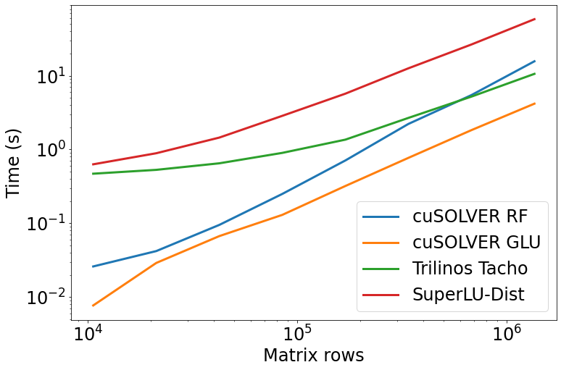
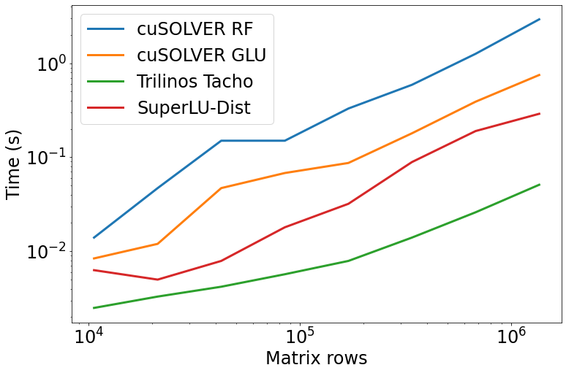
Sparse direct solver GPU (V100) performance
Factorization time
Solve time
cuSOLVER GLU provides best factorization performance
One-time CPU setup expected to be amortized across multiple solves
Trilinos Tacho solver has best triangular solve performance

Slide 26
Preconditioner reuse
Jacobian matrix frequently changes slowly for many problems
Repeating factorization for preconditioner every Newton iteration, every time step is overkill
Selecting factorization frequency not available with Trilinos preconditioners
Reducing to one factorization per time step has no impact on solver convergence!
Actual behavior expected to be highly problem dependent
Automatically determine when to refactor?

Slide 27
Conclusions and future work
AD-generated Jacobians are extremely powerful
No need to compute terms by hand
Require careful attention to achieve performance on GPUs
Continued evaluation of GPU sparse direct solvers
Develop options for AMD/Intel GPUs
SuperLU, Tacho
Reevaluate ILU-based approaches (FastILU?)
Physics-based preconditioning?
Use of low-order approaches leads to less work per domain – may be inefficient on GPUs

Slide 28
Wishlist
Optimizations for matrix scatter operations in Tpetra
Support for customizable preconditioner reuse
More GPU-capable preconditioners
When AMG doesn't work, there aren't many alternatives...
AMD path is unclear (SuperLU?)
Is Tacho the answer?
Refactor-based sparse direct solvers?
Removing nvcc_wrapper

